Slide 1
Python and PyBoard
Lecture 2
Ⓒ 2018 ECSESS RoboElectronics Committee, Slides adapted from Dirk Dubois

Slide 2
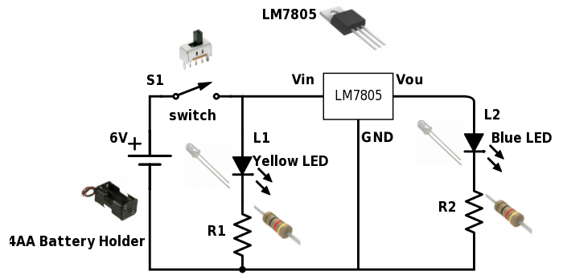
Breadboards and power from last week
Learned how to work with breadboards
Played with LEDs
Too easy according to most of you
Ⓒ 2018 ECSESS RoboElectronics Committee, Slides adapted from Dirk Dubois
‹#›

Slide 3
Final Project
Design a soccer player robot
Ping-pong ball
Powered by a Raspberry Pi and controlled via phone over WiFi
Competition at the last workshop
1 vs 1 or 2 vs 2
Complete specification next workshop

Slide 4
Today’s Tasks
Get the PyBoard working (still configuring the Pi 0)
Turn on and off internal LEDs
Turn on and off an external LED
Turn on and off a motor with a touch sensor
Link to starter code : https://github.com/HanYangZhao/RoboElectronics
Pyboard API : http://docs.micropython.org/en/latest/pyboard/pyboard/quickref.html#

Slide 5
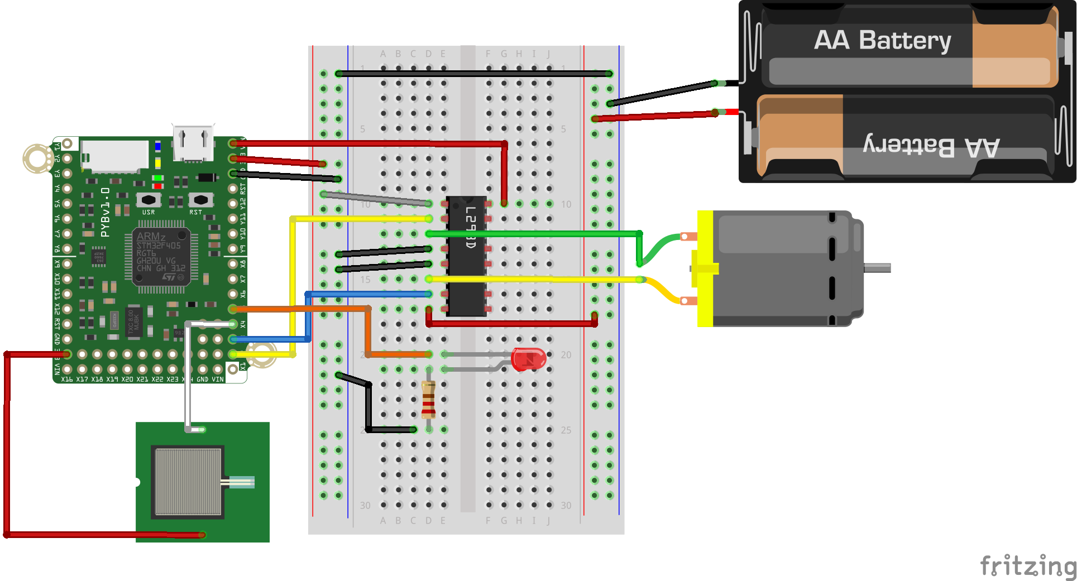

Slide 6
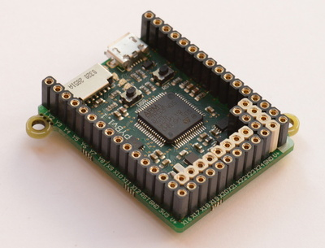
What is a PyBoard?
A microcontroller (mini computer)
Programmed in Python
Control actuators, motors or other chips
Read buttons, switches and sensors

Slide 7
Why Python?
Can be Object Oriented
No need to deal with classes, eazy setup
Interpreted not compiled
Lightweight
Easier syntax
No need to deal with garbage collection

Slide 8
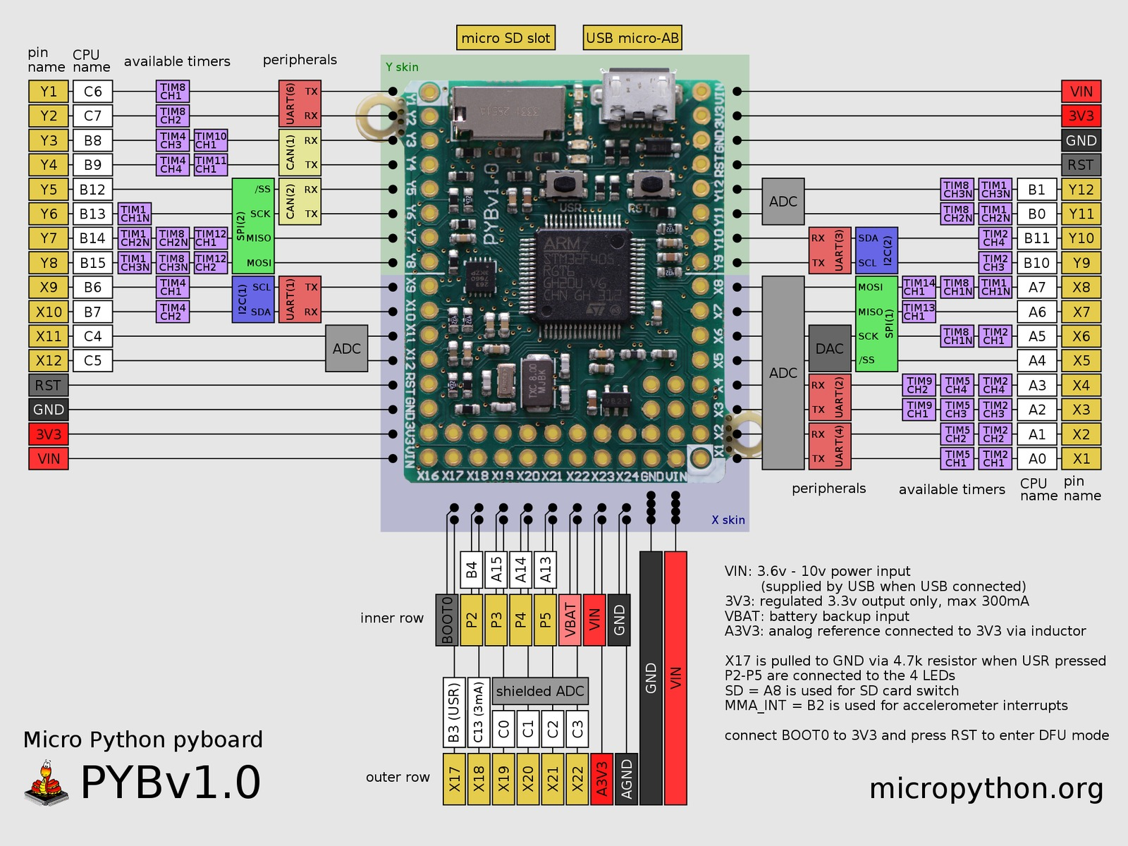
What are all the pins on the Pyboard

Slide 9
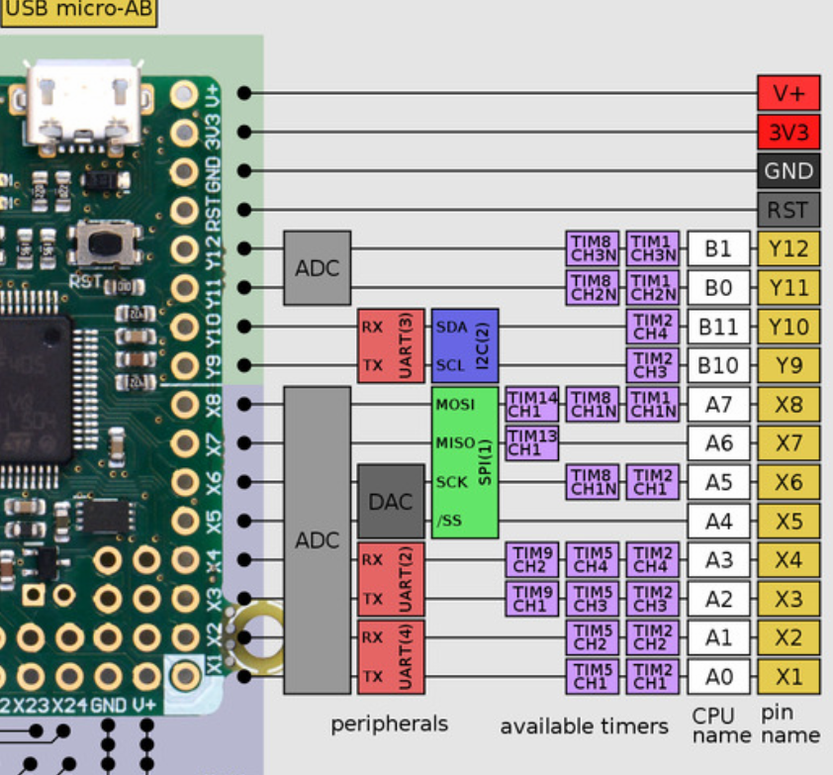
V+ is the voltage of the power supply (eg USB voltage)
3.3V can provide up to 350mA of current.
Don’t drive motors with these pins
The X1 - Y12 are pins name we use in the code, all pins can be used to read or write digital high/low. All pins are 5V tolerant except X5, X6
The ADC pins can read analog value (eg 0 to 5V) and output a number between 0-4095
SPI and I2C are 2 different protocol usually used for sensors
UART is used for serial communication either for sensors or between MCU

Slide 10
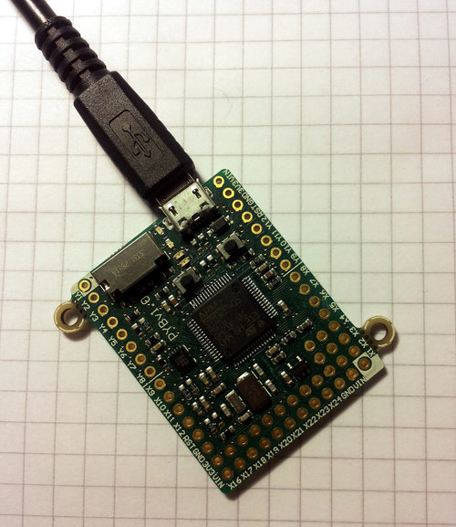
Getting Started
Plug in the pyBoard
Access the pyBoard, and open up main.py
Write your code!

Slide 11
If/Else
Do it or else
i = 2
if ( i == 1 ):
YES
print “i is equal to one”
NO
else:
print “i is not equal to one”

Slide 12
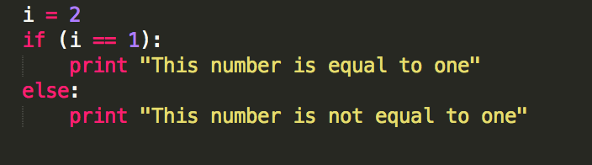

Slide 13
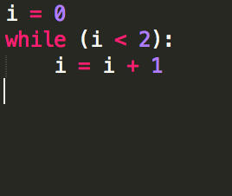
While loops
For while, you must learn
i = 0
while ( i < 3 )
YES
i = i + 1
//Do something
NO
exit loop

Slide 14
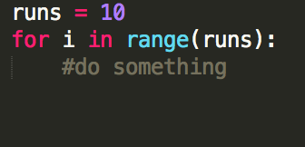
For loops
For while, you must learn
for i in range(20)
i < 2
//Do something
i > 2
exit loop

Slide 15
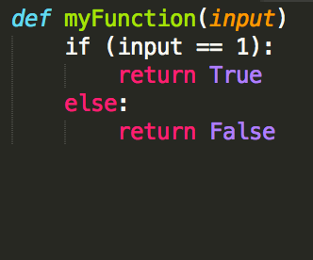
Defining functions
Gotta func.

Slide 16
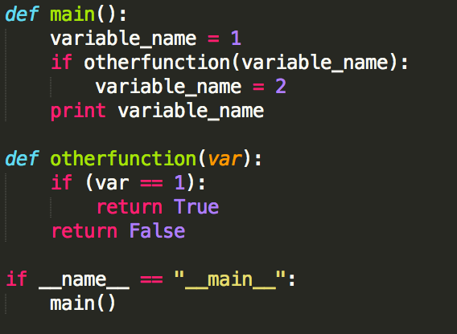
Using functions
Because you can’t use a definition alone
Main function
You can use functions even as conditions!
Calls for the main method to be executed first

Slide 17
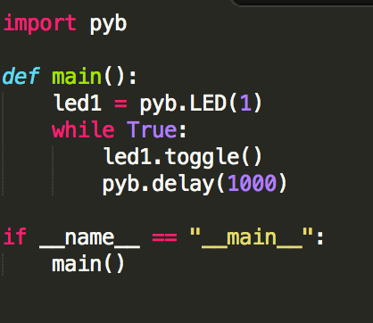
Toggling the internal LED
No semi-colon, but spacing is very important
http://docs.micropython.org/en/latest/pyboard/pyboard/quickref.html

Slide 18
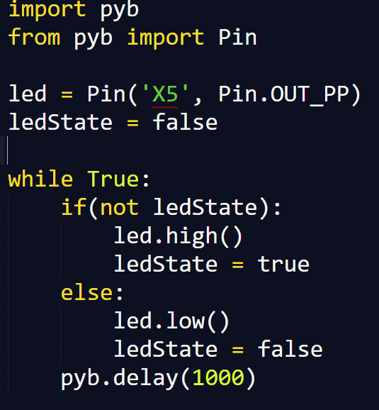
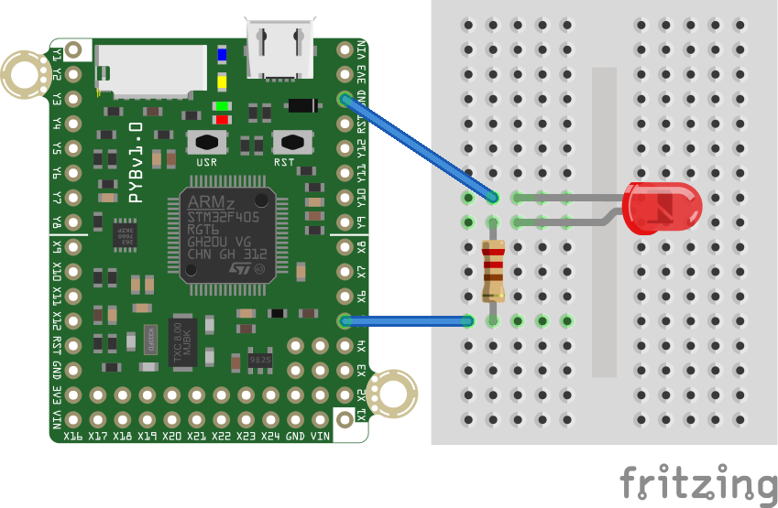
Turning on an external LED
‹#›

Slide 19
Analog to Digital Converters
Previously, we could only read voltages as 1 or 0
If you want to read a continuous voltage, you need an ADC
We ‘bracket’ the continuous voltages into digital signals

Slide 20
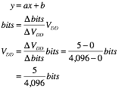
Mapping
Always good to know where you’re going
We need to be able to linearly map a 12 bit ADC value to a voltage we can read

Slide 21
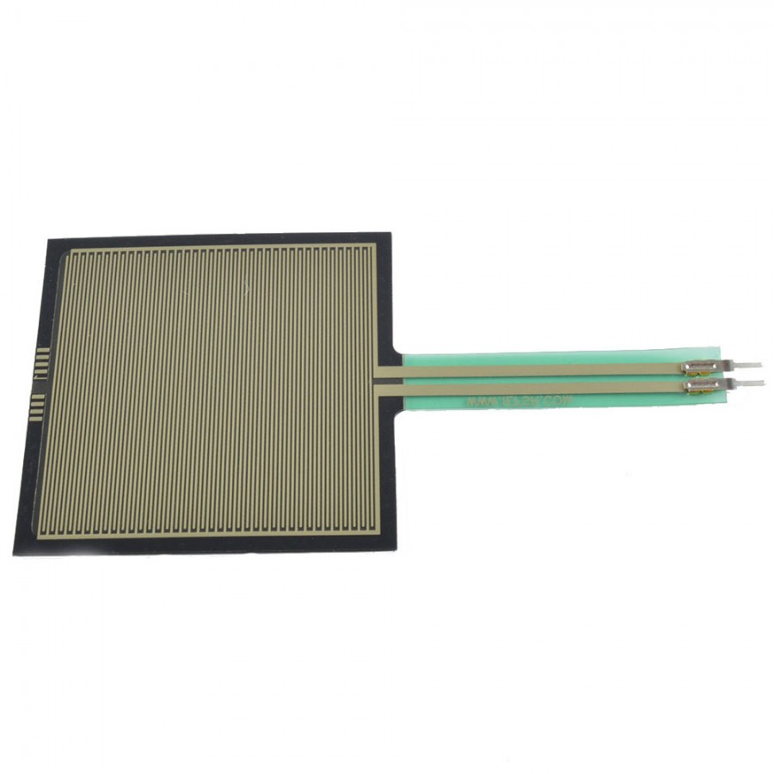
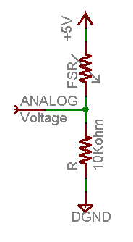
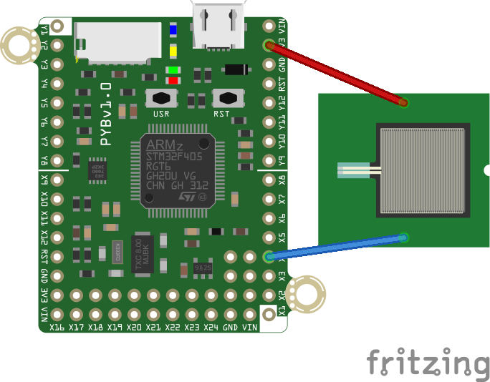
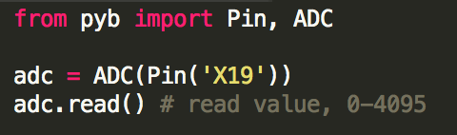
Force sensitive resistor
High resistance when untouched, resistance drops down when touched allowing voltage to pass through
Use the ADC pins of the PyBoard to read the value of the touch sensor

Slide 22
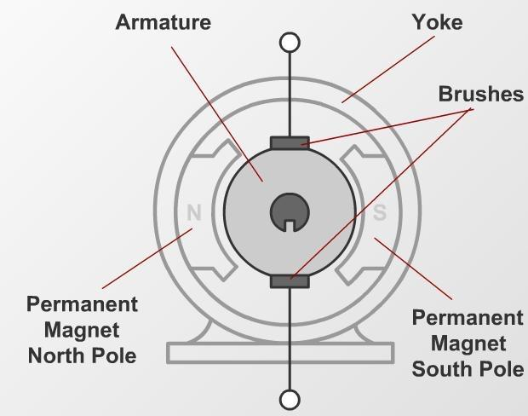
DC motors
Marvellous, don’t you think
Permanent Magnet Brushed DC (PMDC) motors
Linear voltage to speed
Linear current to torque
Polarity affects direction
If you’re not sure which direction the motor will turn, try.

Slide 23
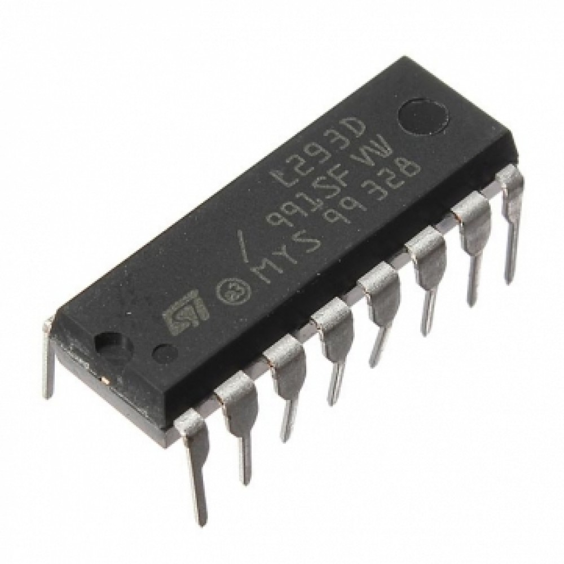
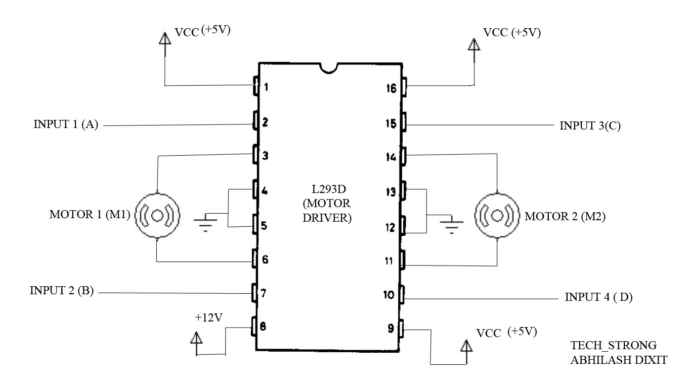
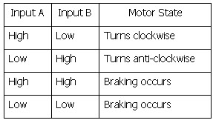
H-Bridge - L293
Drive motor with higher voltage than what the MCU can provide
Run motor forward and backward by alternating the value of A/B
Pin 1 and 9 can be controlled using PWM to control motor speed

Slide 24
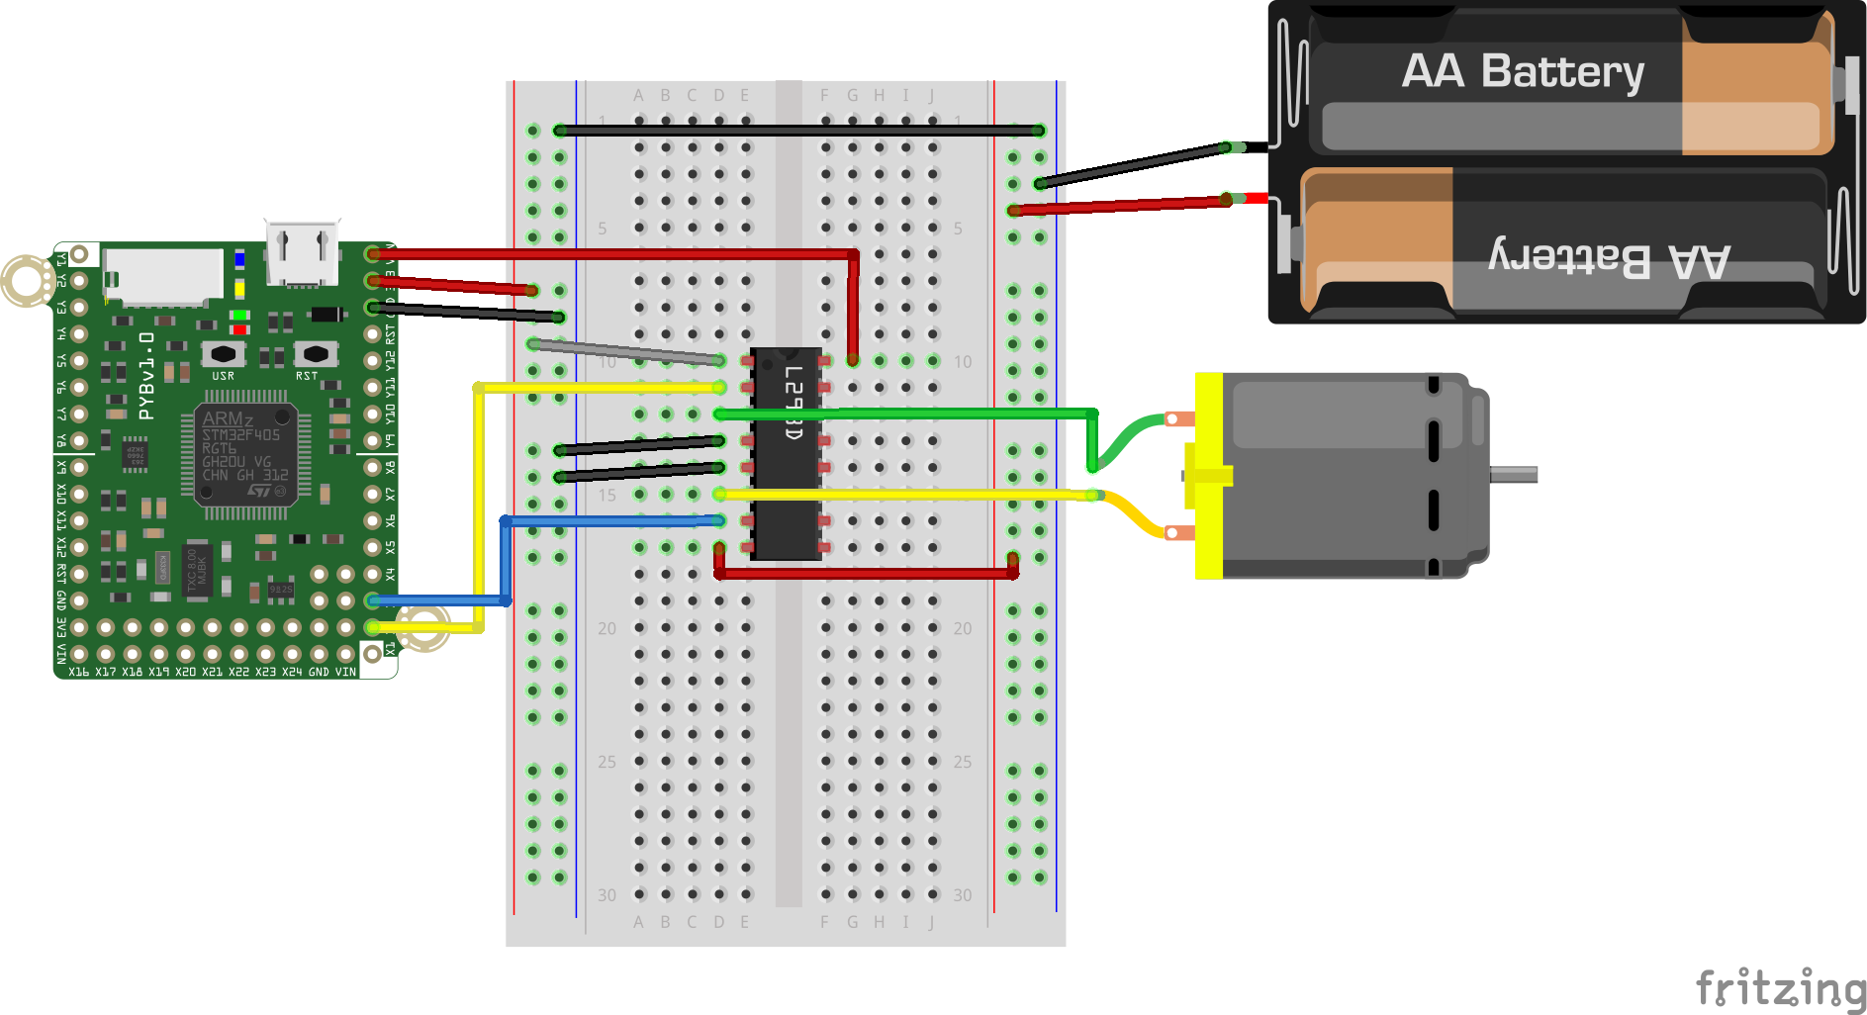

Slide 25
Debugging code
Download MobaXTerm

Slide 26
Today’s Tasks
Get the PyBoard working (still configuring the Pi 0)
Turn on and off internal LEDs
Turn on and off an external LED
Turn on and off a motor with a touch sensor
Link to starter code : https://github.com/HanYangZhao/RoboElectronics
Pyboard API : http://docs.micropython.org/en/latest/pyboard/pyboard/quickref.html#

Slide 27
Next Week
Introduction to RPi
Linux basics
Network configuration and accessing RPi over SSH
Migrating what we did today to the RPi
Introduction to source versioning (GIT)
Software to download : MobaXTerm and Bonjour service only if using windows

